Slide 1
Using Logistic regression to predict Pollution due to Data centers in India
Team members:
Sahil Sheikh
Yatharth Surana
Siddhant Varyambat
Shayan Saha

Slide 2
What is Linear regression
Linear regression is when we take one variable as input and map an output.
For example
If we want to predict the property prices in a city for example, we will take the input as the floor size and the output as the cost.
So since we have the data from last 10 years we can approximate how the property prices will change in the next 10 years.

Slide 3
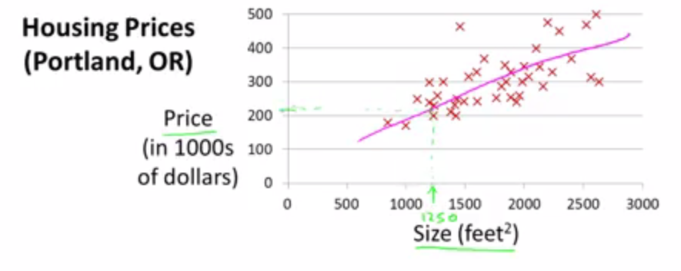
This is when Linear regression is applied to Portland in USA

Slide 4
The Hypothesis Function
Our hypothesis function has the general form:
hθ(x)=θ0+θ1x
We give to hθ values for θ0 and θ1 to get our output 'y'. In other words, we are trying to create a function called hθ that is able to reliably map our input data (the x's) to our output data (the y's).

Slide 5
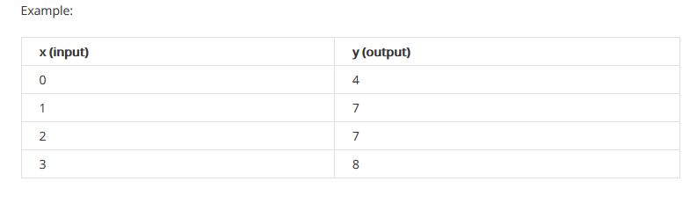
Let us assume this is the given data set
Now we can make a random guess about our hθ function: θ0=2 and θ1=2. The hypothesis function becomes hθ(x)=2+2x.
So for input of 1 to our hypothesis, y will be 4. This is off by 3.

Slide 6
COST FUNCTION
Cost Function
We can measure the accuracy of our hypothesis function by using a cost function. This takes an average (actually a fancier version of an average) of all the results of the hypothesis with inputs from x's compared to the actual output y's.
J(θ0,θ1)=(∑hθ(x(i))−y(i))^2/)2m
Here m is total values of x available

Slide 7
Gradient Descent
So we have our hypothesis function and we have a way of measuring how accurate it is. Now what we need is a way to automatically improve our hypothesis function.
That's where gradient descent comes in.

Slide 8
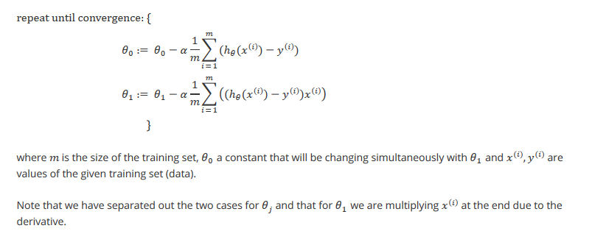
Gradient Descent for Linear regression

